Slide 1
ROllerBall
Silei Ren
Xuanyu Zhou
August 2016

Slide 2
What is rollerball?
Idea
Notes:
Rollerball is a Webgl application that renders an arbitrary function of rail and a ball rolling down from the beginning to the end according to real-world physical mechanism.

Slide 3
Getting started
WebGL
Lightgl.js by Evan Wallace
Intereact.js by Taye Adeyemi
Notes:
Lightgl: lower level WebGL library comparing to many other popular webgl library like three.js, provides similar openGL functionality that works under WebGL structure, but not a scene graph.

Slide 4
Visual
Sphere
Rail
Skybox
Phong and shadowmap GLSL shaders
Control Panel

Slide 5
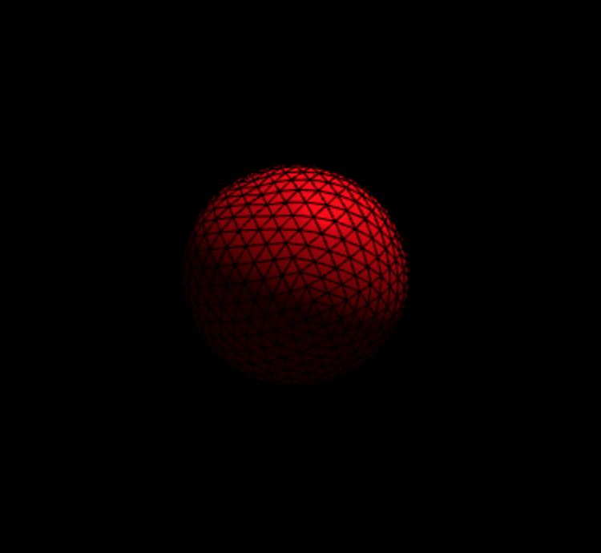

Slide 6
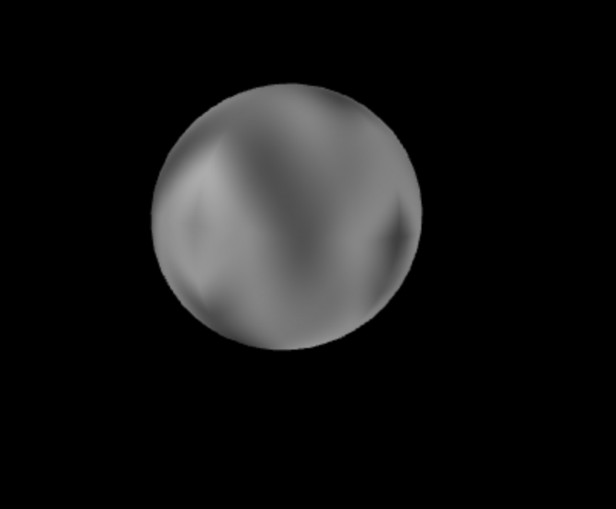

Slide 7

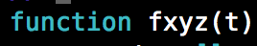
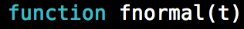
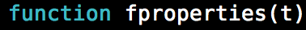

Slide 8
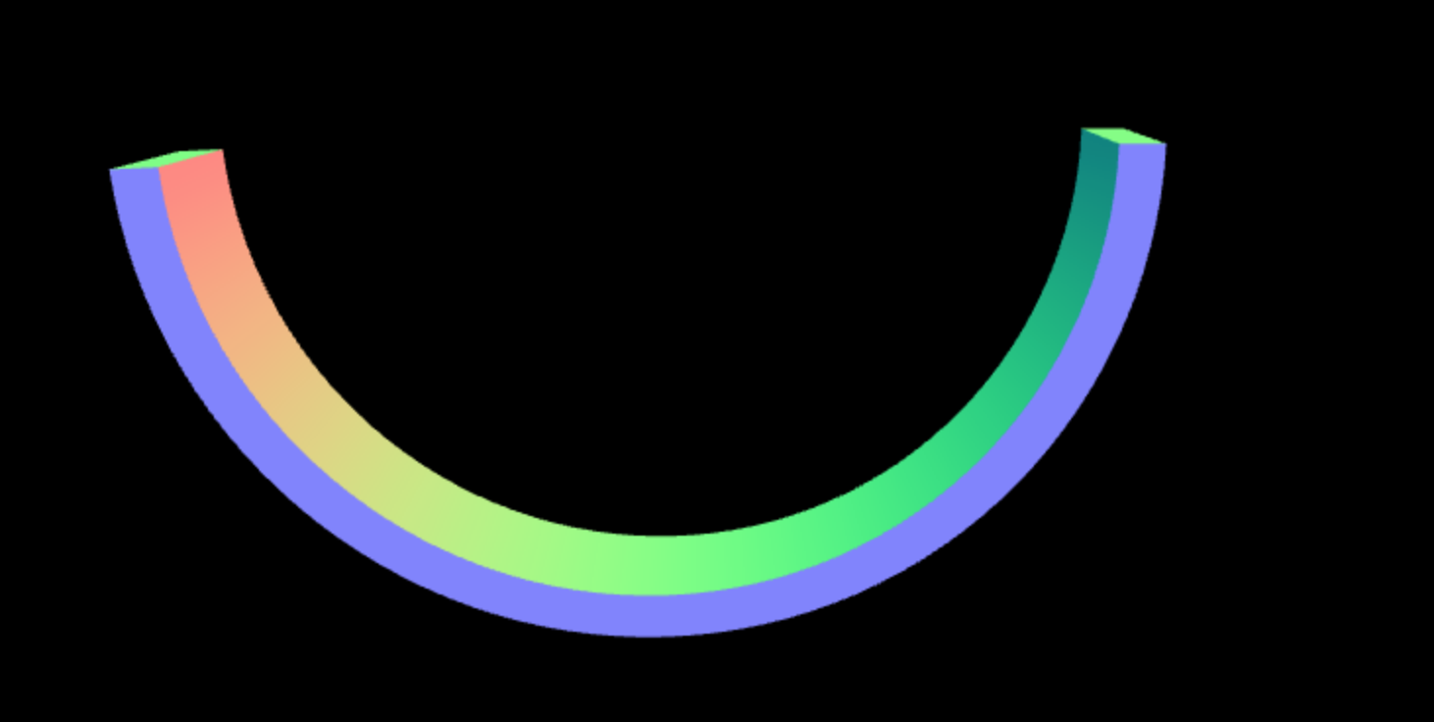

Slide 9
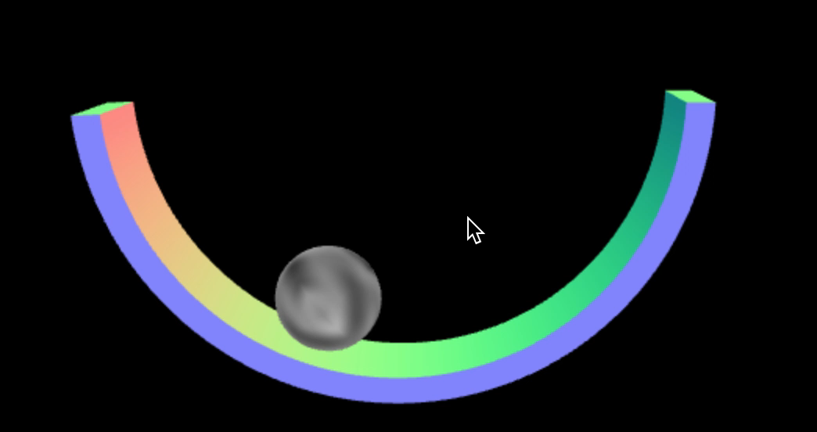

Slide 10
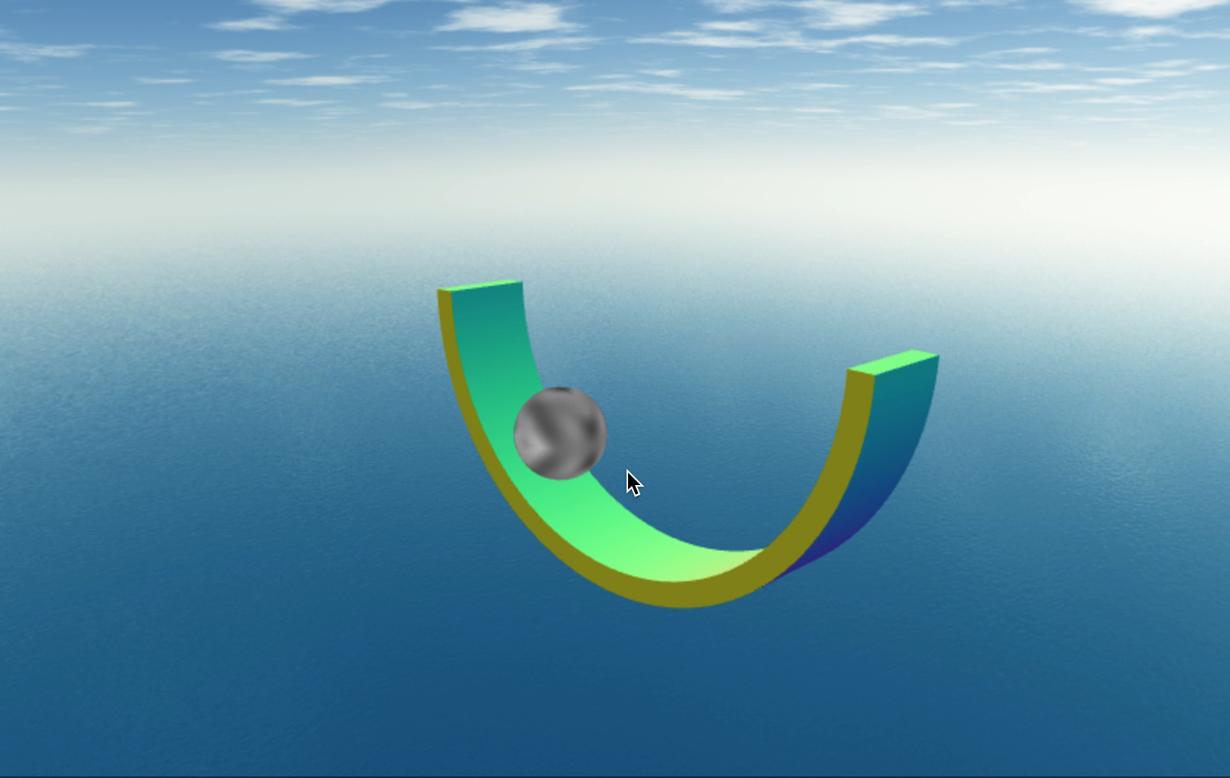

Slide 11
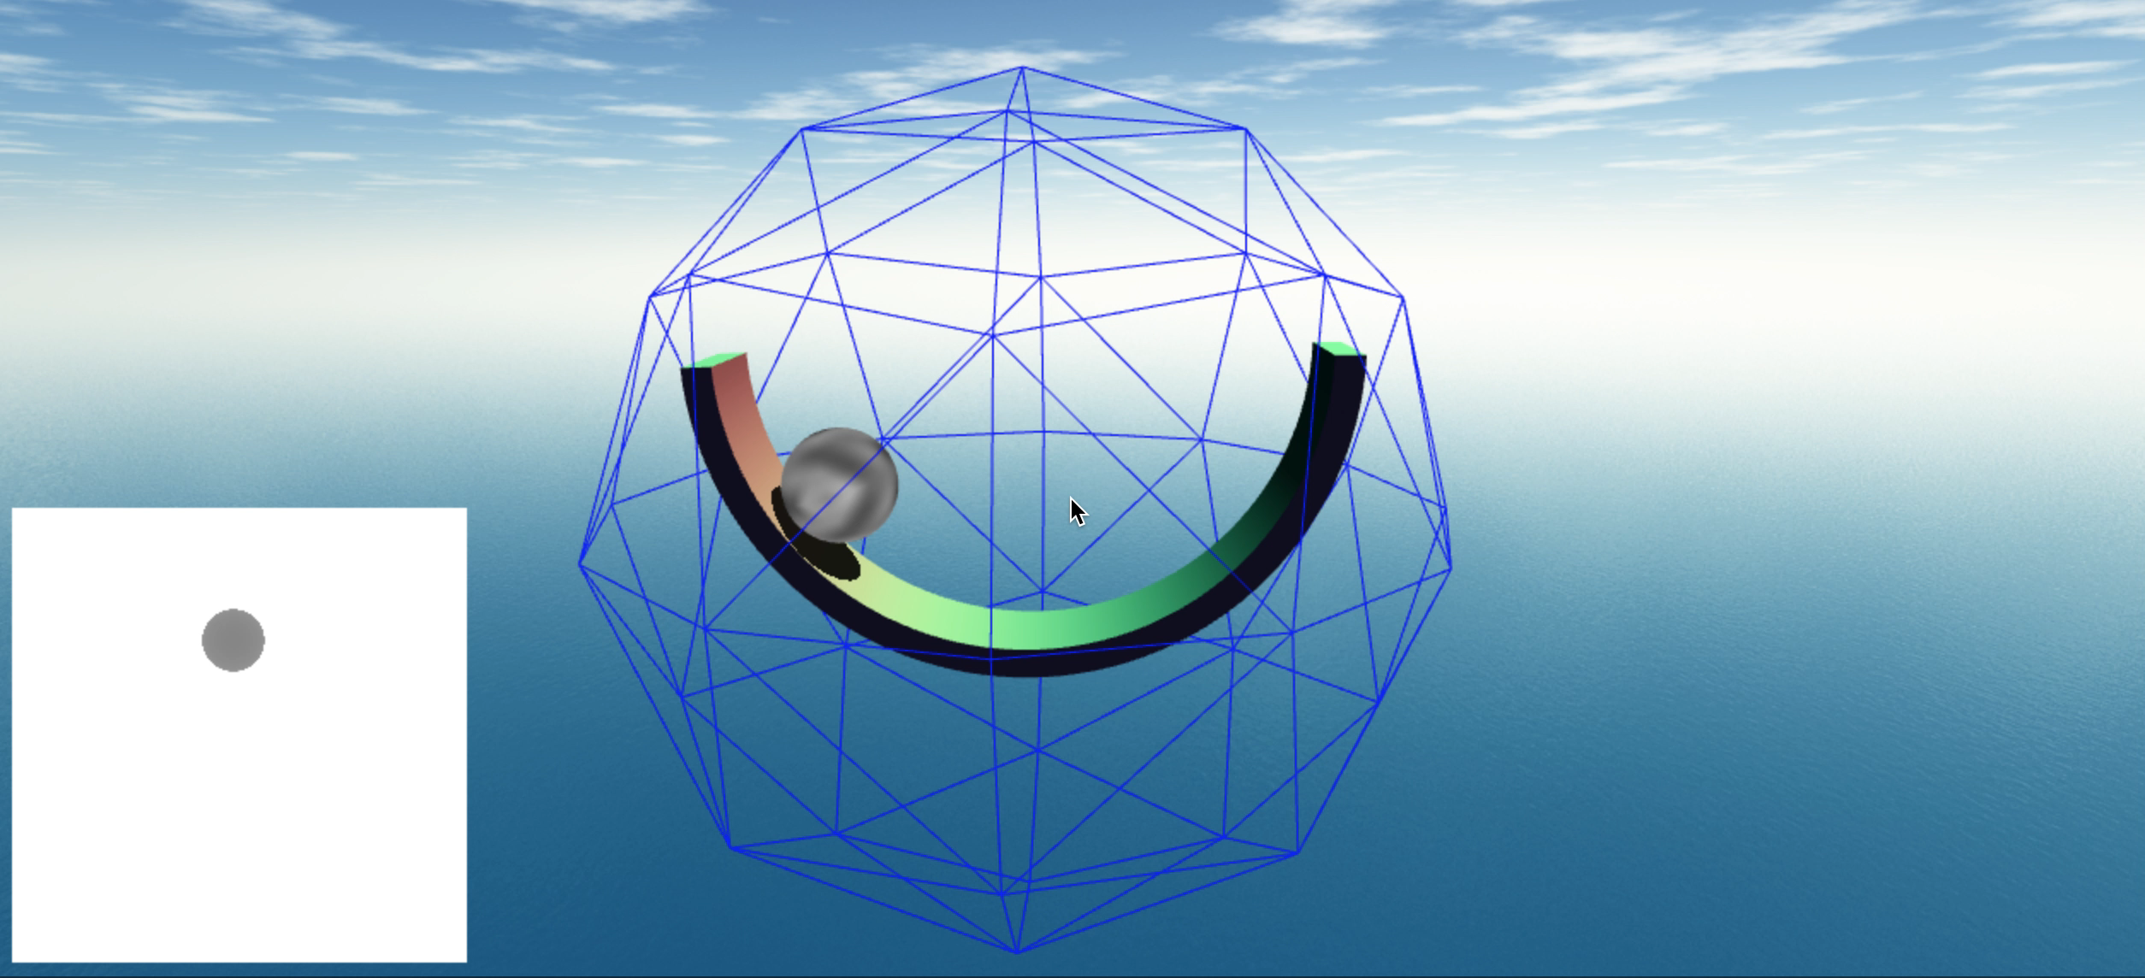

Slide 12
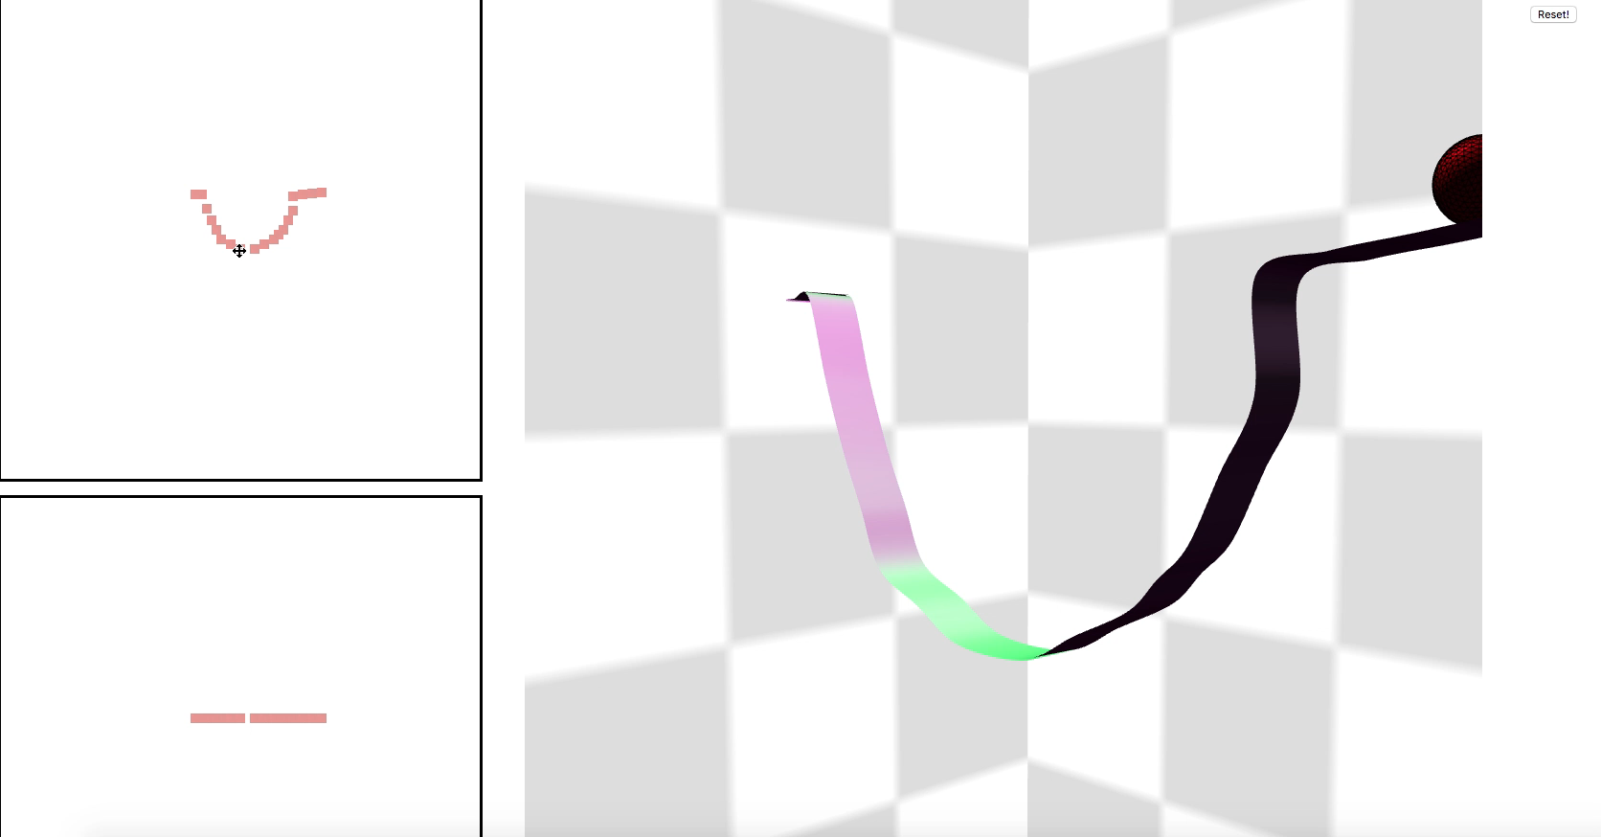

Slide 13
PHYSICAL
Rail generation
Ball movement
Ball rolling
Changing perspective

Slide 14
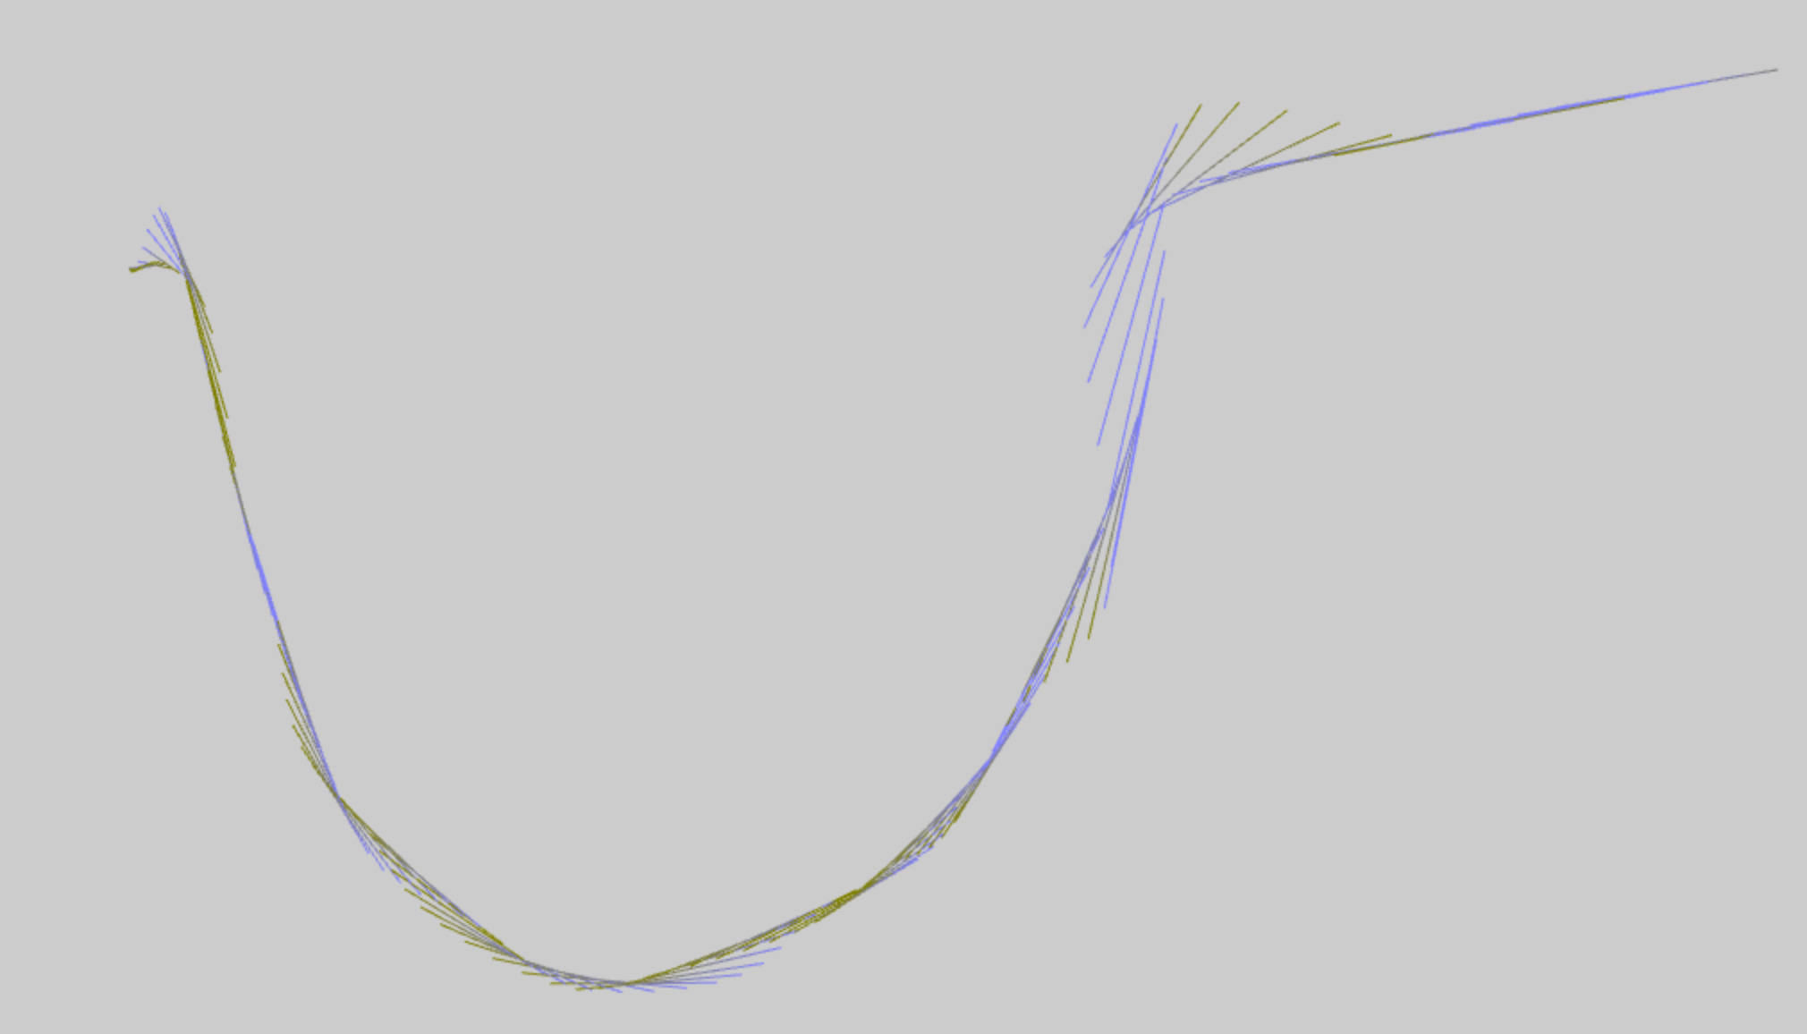
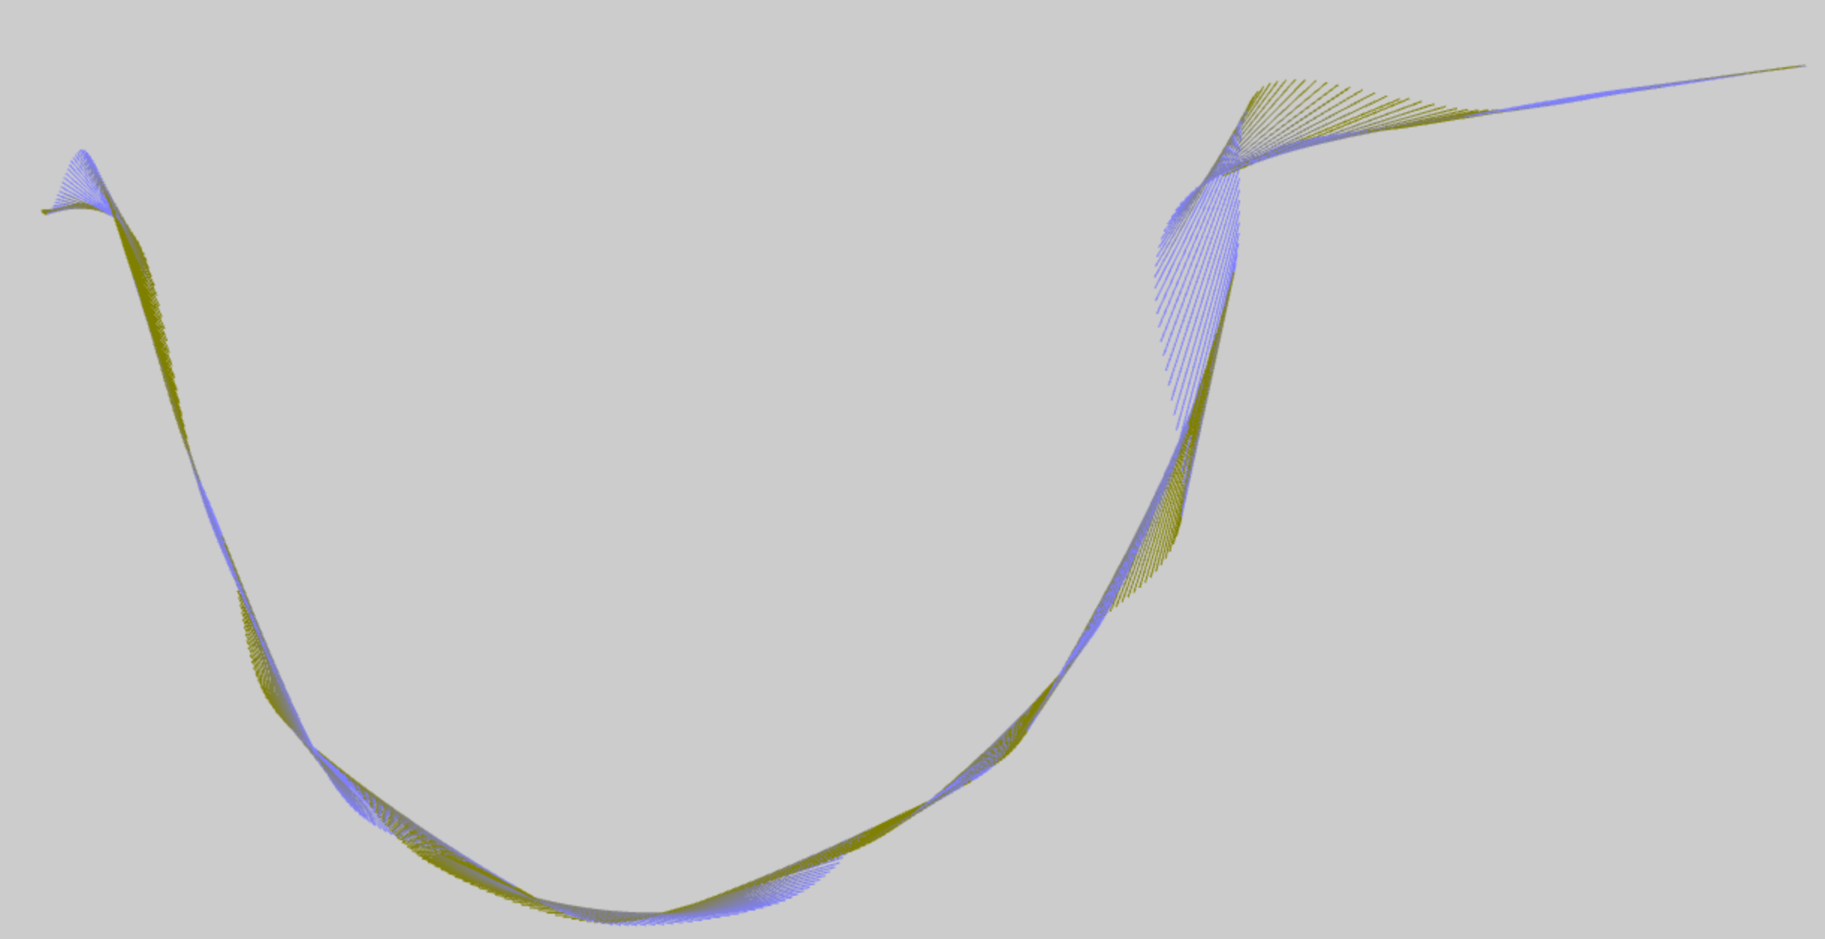
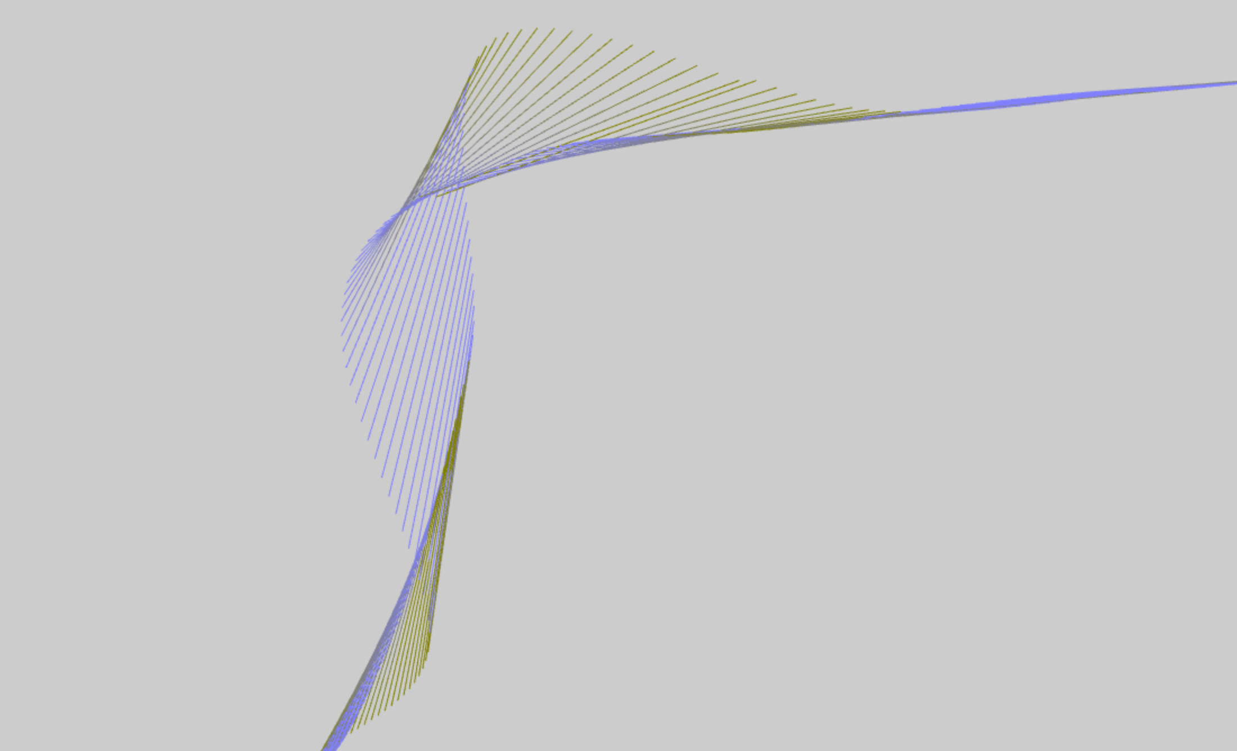
tangents

Slide 15
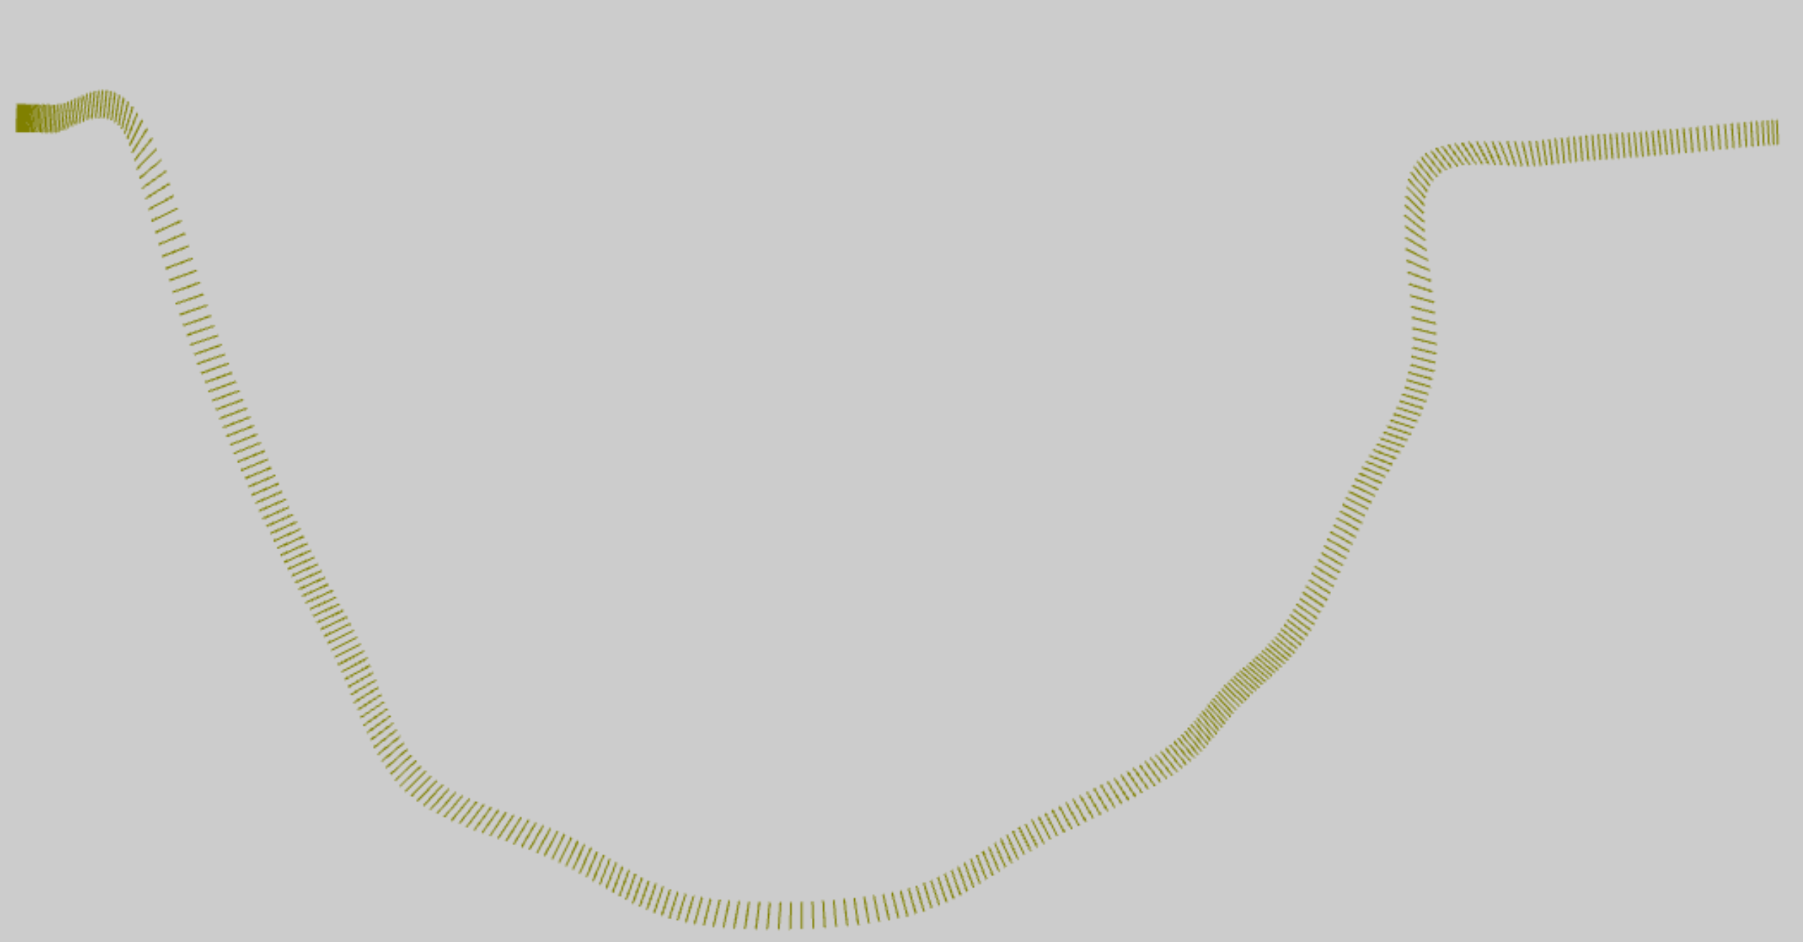

normals

Slide 16
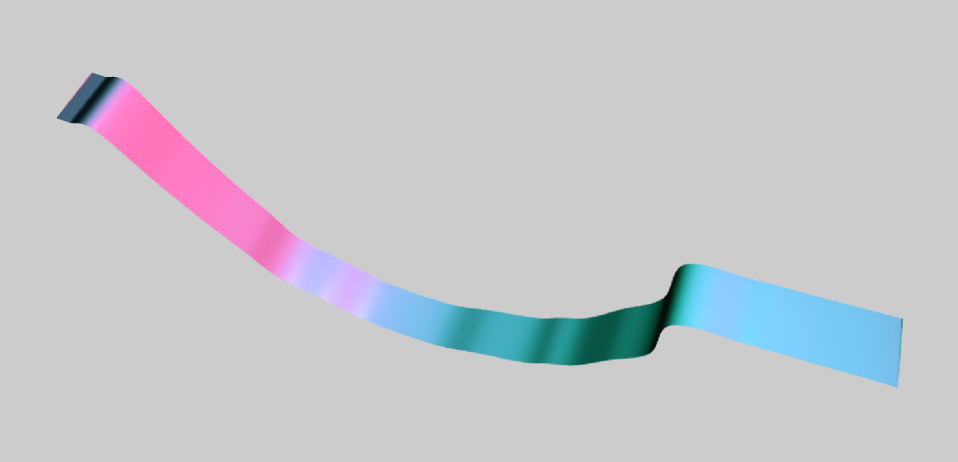
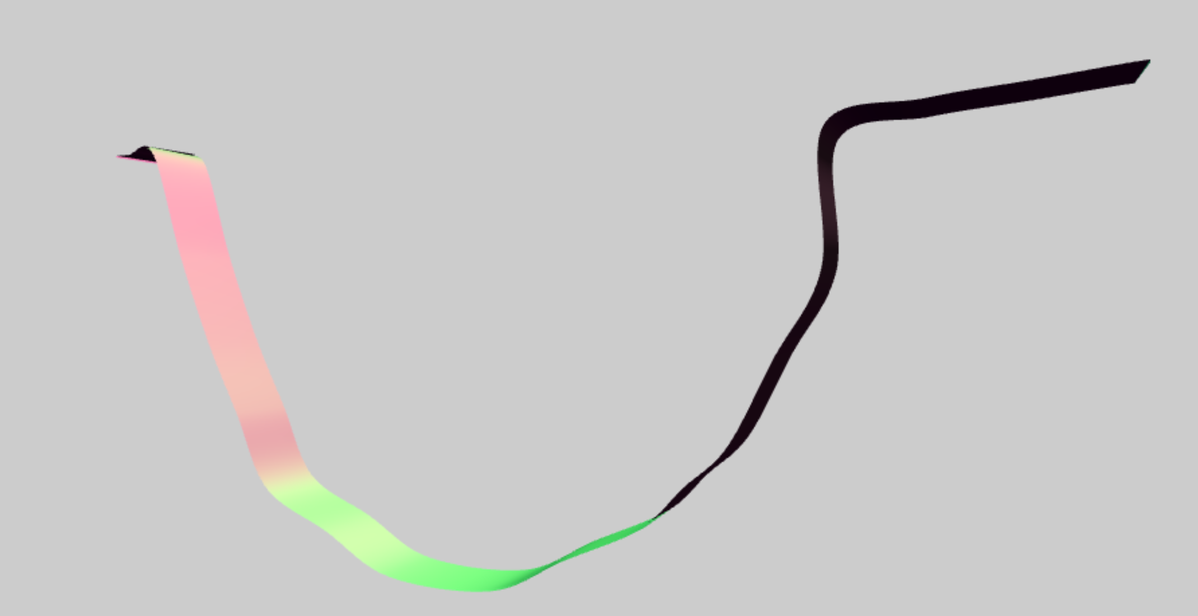
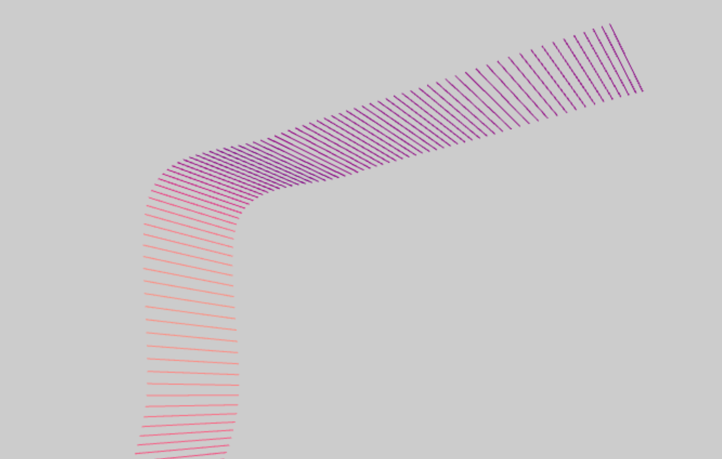
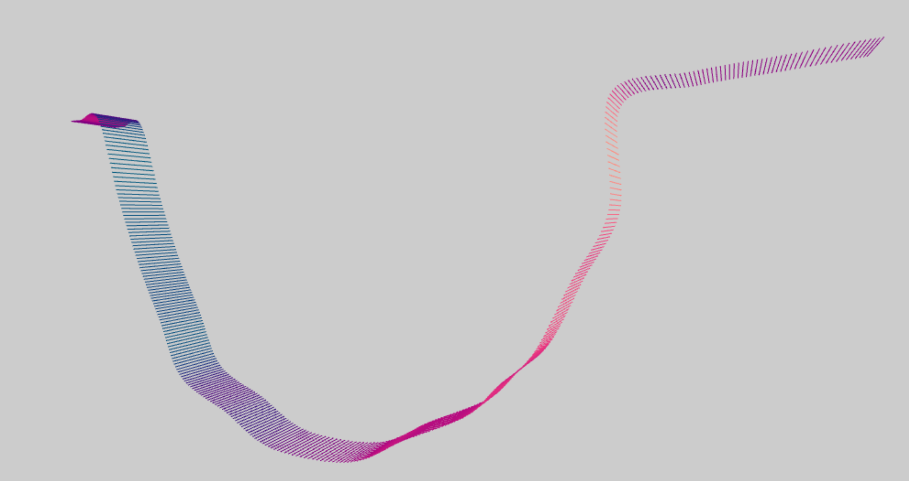
rail

Slide 17
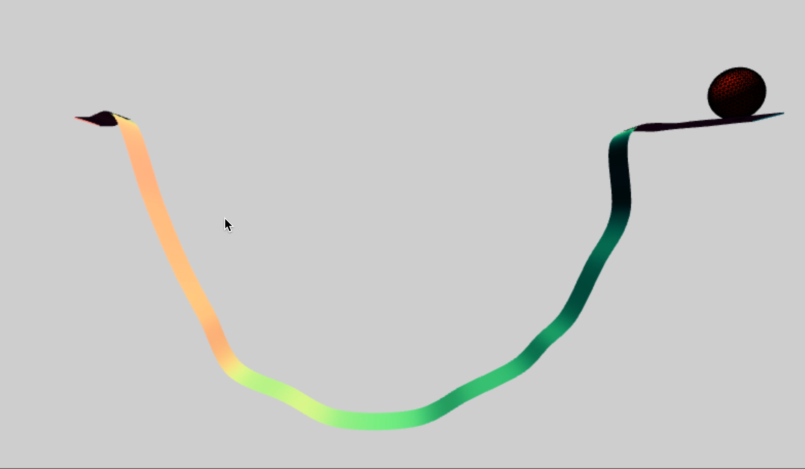

Slide 18
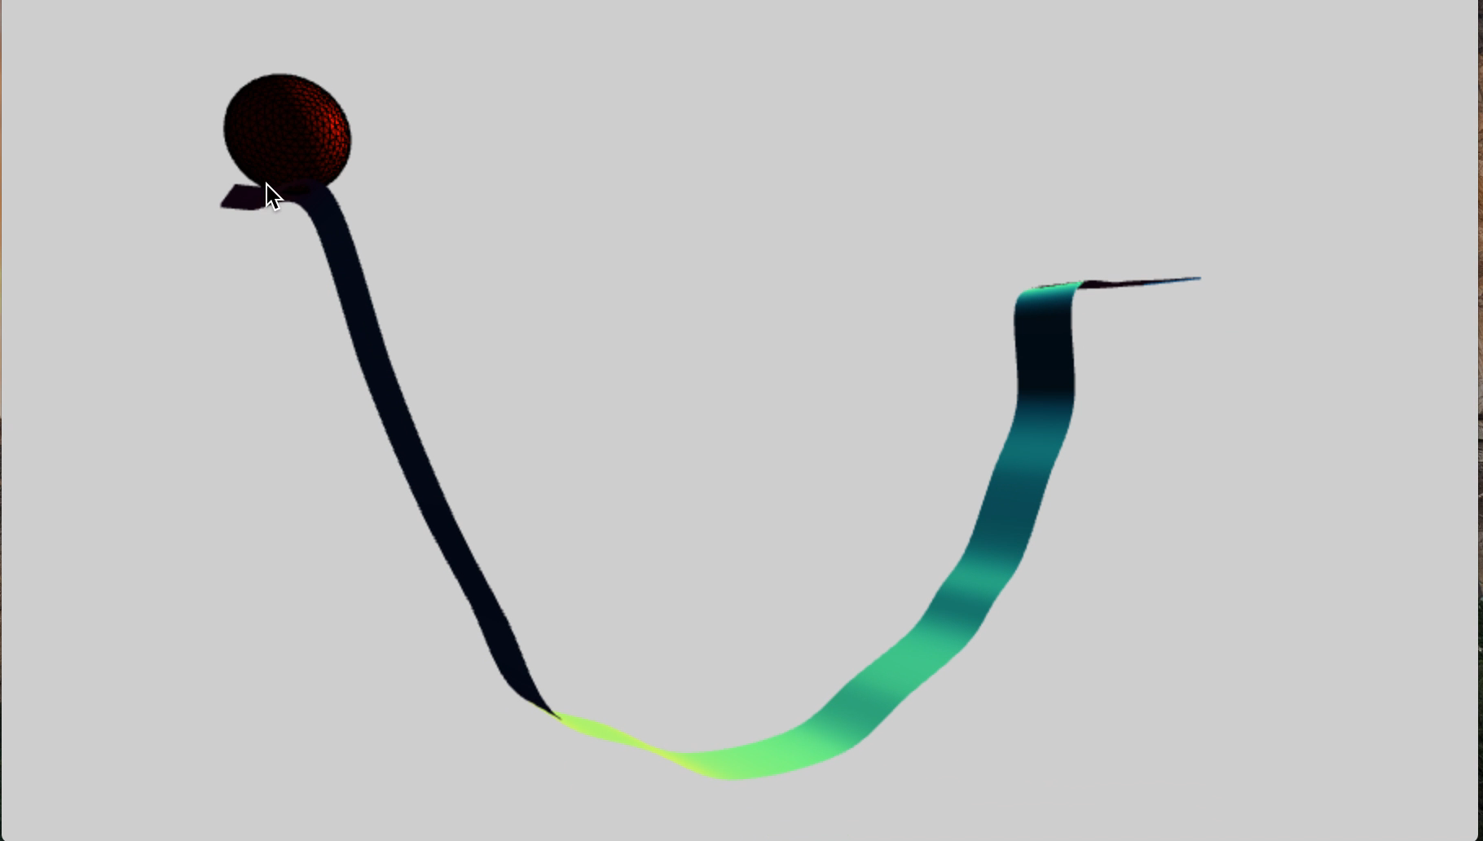

Slide 19
Final result
https://Slash0BZ.github.io/projects/rollerball/final/index.html

Slide 20
Hoping to do more!
Algorithm (noun.)
Word used by programmers when they do not want to explain what they did.
(Source unknown)

